Slide 1
LANGUAGE TRANSLATOR

Slide 2

CONTENTS
INTRODUCTION
OBJECTIVE
WHY TRANSLATION NECESSARY
WHY WE NEED IT
BACKGROUND OF STUDY
MODES OF LANGUAGE TRANSLATION
FUTURE SCOPE
LANGUAGES USED
BENEFITS
CONCLUSION

Slide 3
INTRODUCTION
01
Translation is the process of converting a written source language text clearly, completely , accurately and appropriately in a target language .
Translation allows information to be transferred across languages, expanding accessibility or the information .
Translation process involves translation , editing , and proofreading .
The word TRANSLATION refers to the product of this activity , the final target language text that will be published or distributed.

Slide 4
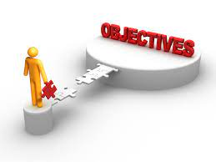
OBJECTIVE
02
The goal of translation practice for non-specialist is to found the language skills of the learner , to refine their thematic and cultural knowledge and to encourage them to think and to react .
Here are some of the objectives :
Develop a system which is able to do conversion between the languages.
Provide an essay and simple for translation.
Endow good experience to the user
Translate almost each language

Slide 5

WHY TRANSLATION IS NECESSARY ?
03
Better Understanding :
When you live in other country you faces a lot of difficluties mainly of language, you needs them to be translated for a better understanding
Business Deals :
While dealing with the people of other countries we needs to talk to them in their language .
1
Studies :
More often whenever a student , he/she found some difficult words which are supposed to be translated to his/her native language
Cultural interchange :
music, literature ,films , and various other art forms transcend global boundaries because of the way they are effectively translated to reflect local languages and sentiments

Slide 6
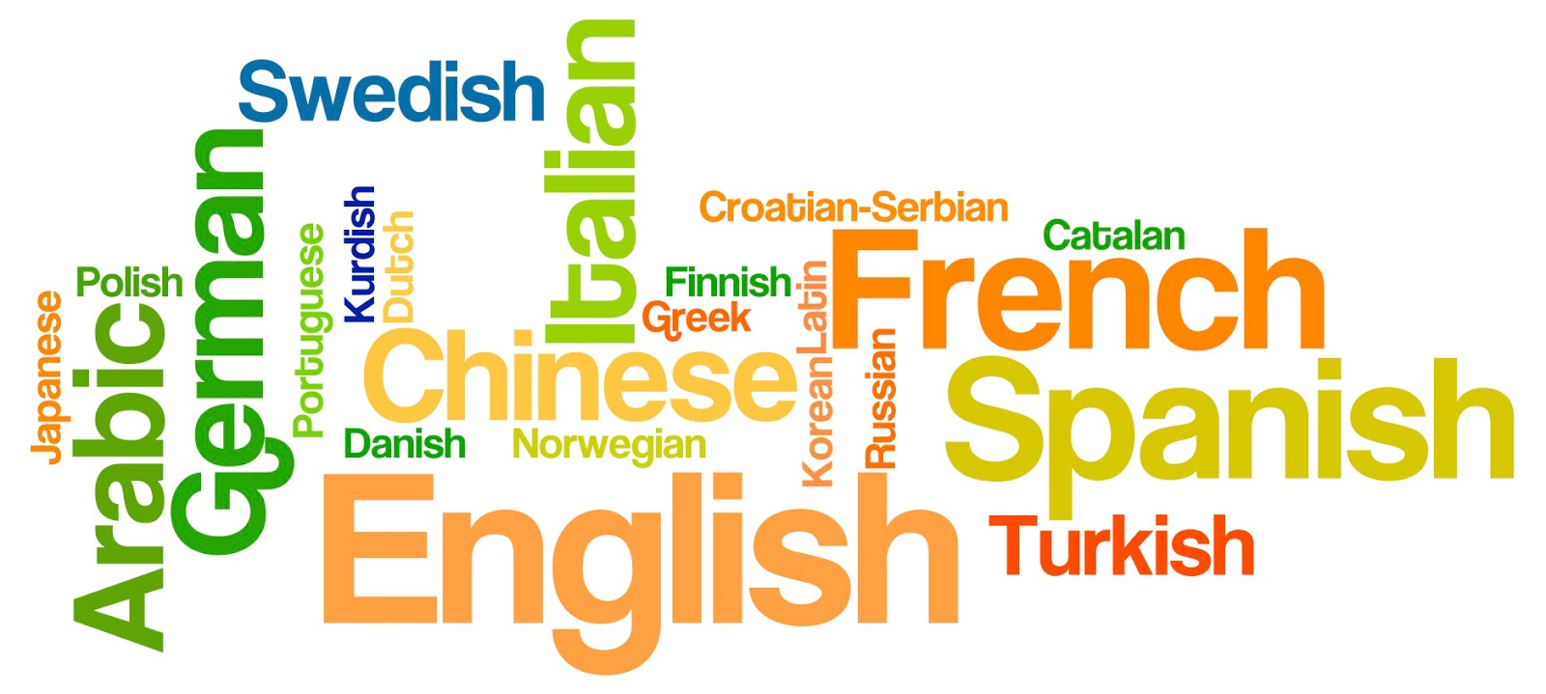


WHY WE NEED IT ?????
04
READING
While we are reading anything and didn’t get any specific word then we needs it to be translated
WRITING
Some time it happens that we skip some words from our mind and we remember that in other languages

Slide 7
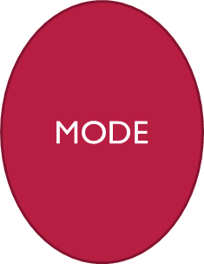

MODES OF LANGUAGE TRANSLATOR
MODE
05
01
WRITING : FIRST YOU NEED TO WRITE THE TEXT YOU WANNA TRANSLATE
02
PROCESSING : THEN THE TRANSLATOR WILL TRANSLATE THE LANGUAGE TO YOUR DESIRED LANGUAGE
03
OUTPUT : OUTPUT WILL BE IN YOUR TRANSLATED LANGUAGE

Slide 8
FUTURE SCOPE
06
The future translation will cover more cultures , as the internet continues to penetrate in emerging countries worldwide. Besides the top languages for translation, the software will have to provide accurate solutions to communicate with audiences who speak less known dialets .

Slide 9
LANGUAGES USED
07
<<<<<< HTML , CSS , JAVASCRIPT >>>>>>
HTML:
HTML is the language for describing the structure of Web pages. HTML gives authors the means to: Publish online documents with headings , tables, texts, lists, photos etc.HTML (the Hypertext Markup Language) and CSS (Cascading Style Sheets) are two of the core technologies for building Web pages. HTML provides the structure of the page, CSS the (visual and aural) layout, for a variety of devices. Along with graphics and scripting , HTML and CSS are the basis of building Web pages and Web Applications.
CSS :
CSS is the language for describing the presentation of Web pages, including colours, layout, and fonts. It allows one to adapt the presentation to different types of devices, such as large screens, small screens, or printers. The separation of HTML from CSS makes it easier to maintain sites, share style sheets across pages, and tailor pages to different environment.
JAVASCRIPT :
JavaScript is a light-weight object-oriented programming language that is used by several websites for scripting the webpages. It is an interpreted, full-fledged programming language. JavaScript enables dynamic interactivity on websites when it is applied to an HTML document. JavaScript makes web pages more dynamic and user-friendly so that they respond to visitors' actions. Or, to put it another way, JavaScript makes web pages interactive.

Slide 10

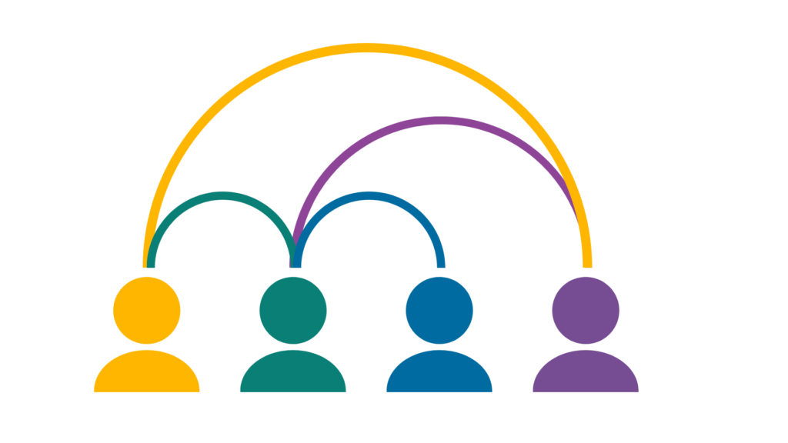

BENEFITS
08
INDEPENDENT WORKING
QUICK CARRER PROGRESSION
LEARNING NEW THINGS EVERY TIME
ACTING AS A NETWORK COMPONENT
PROVIDES INTERACTION
SAVES TIME

Slide 11
CONCLUSION
09
A good translation is a translation that can be a bridge of communication between two languages.
This is line with the purpose of translation, which is to produce translated works and to help overcome language differences in.

Slide 12

THANK
YOU

